Slide 1
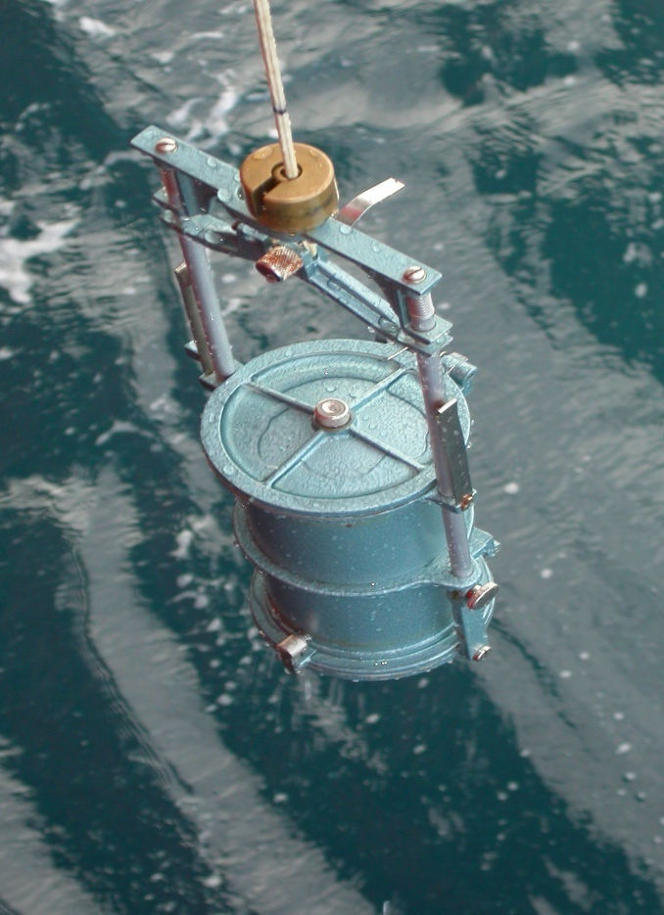
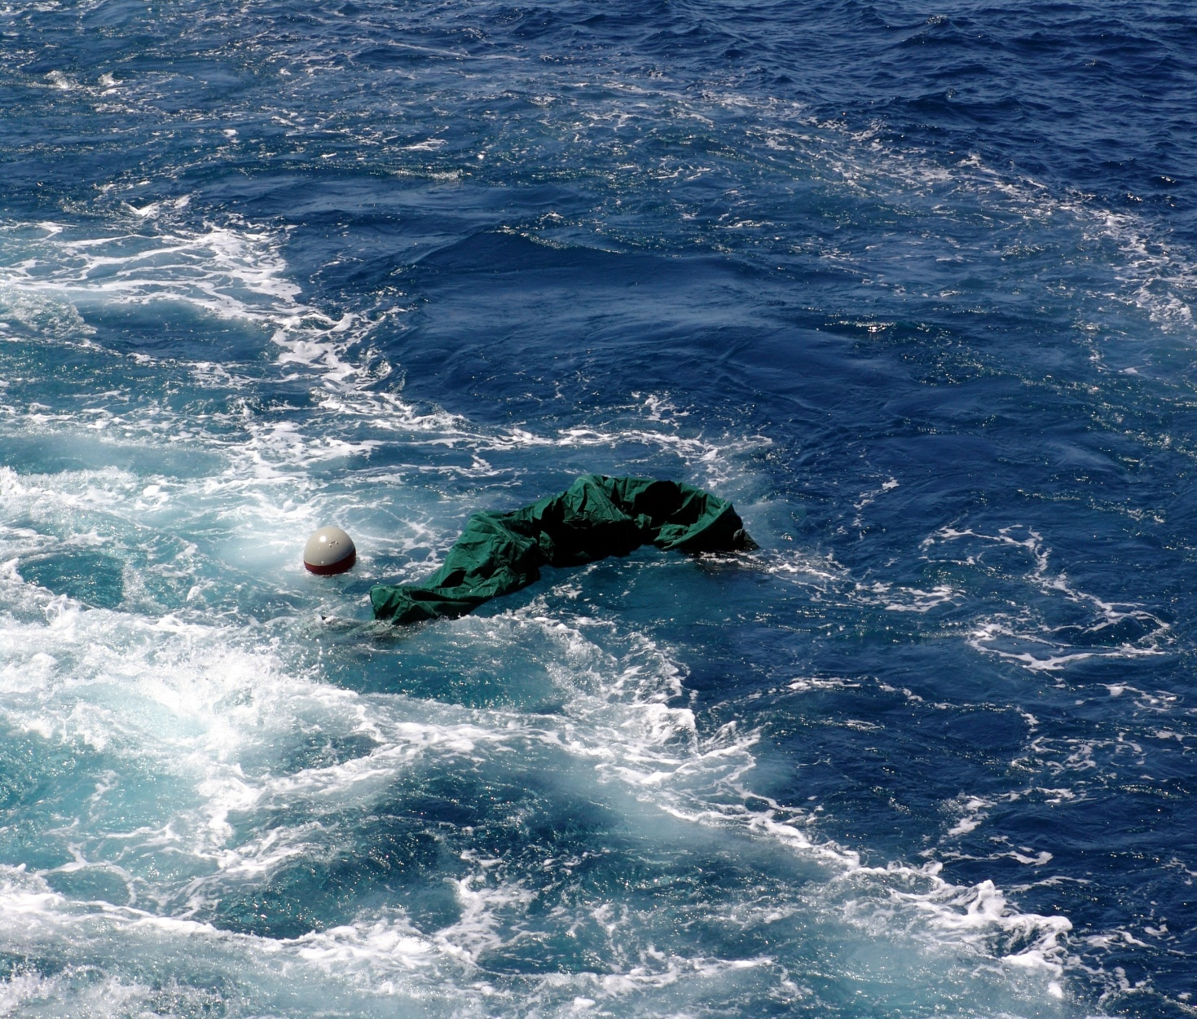
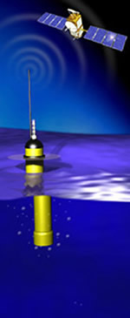
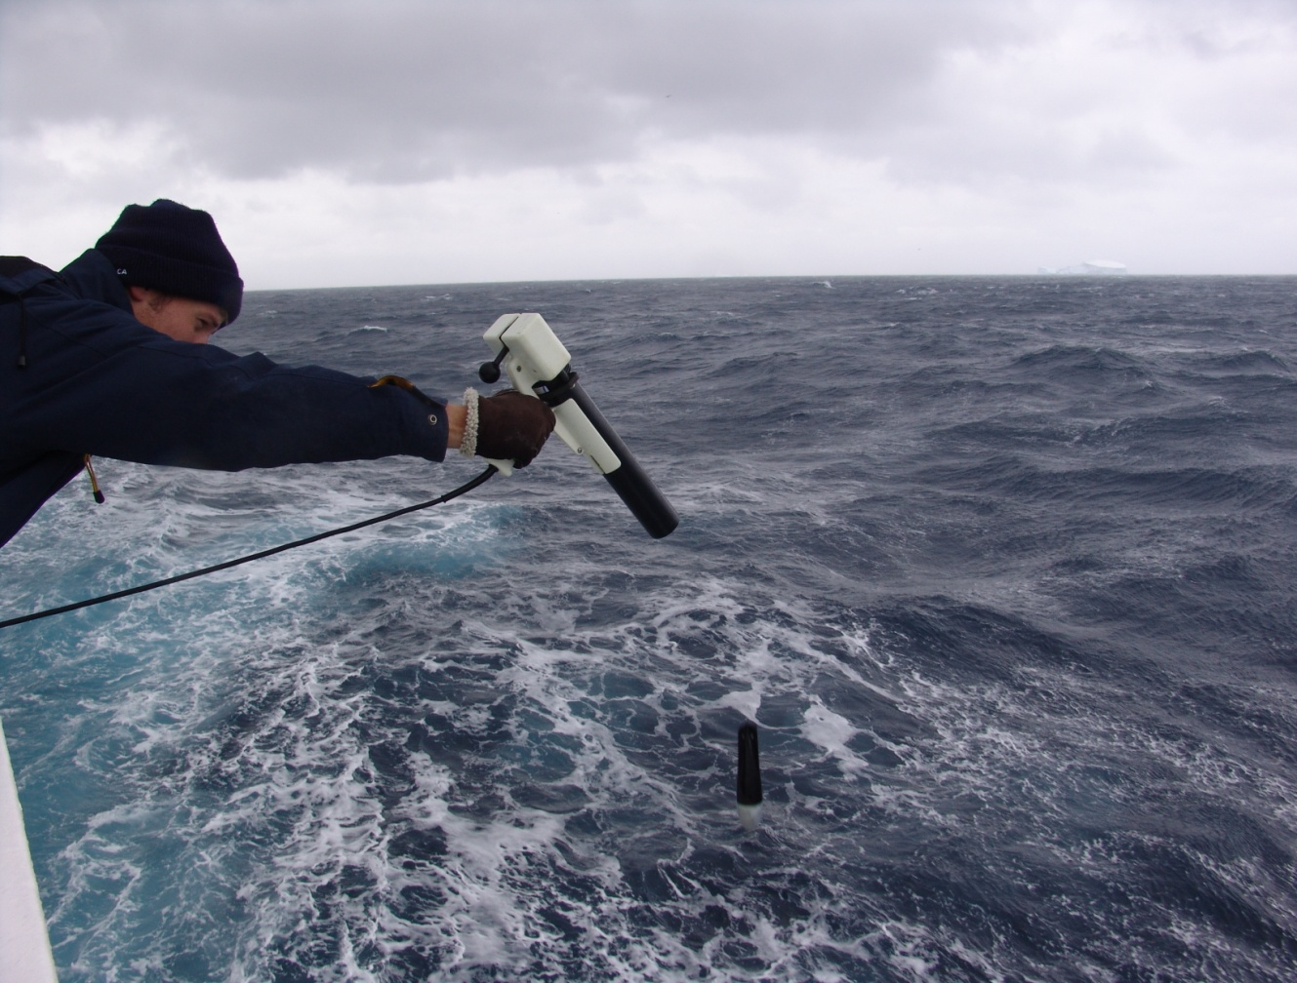
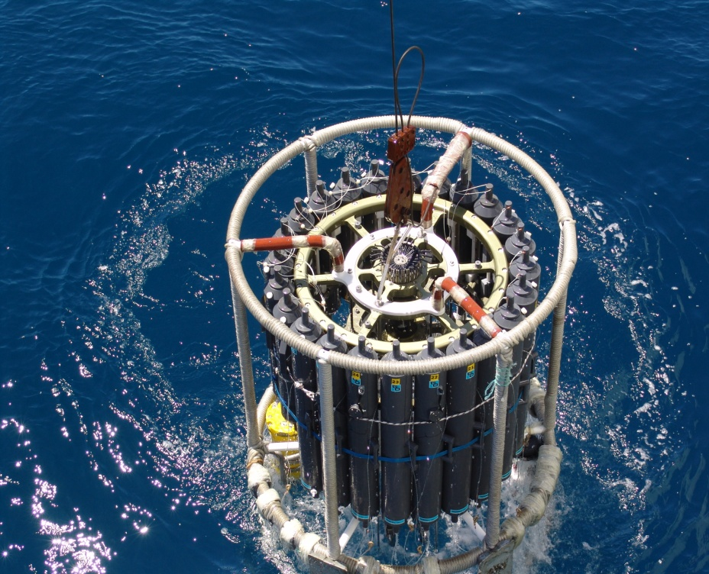
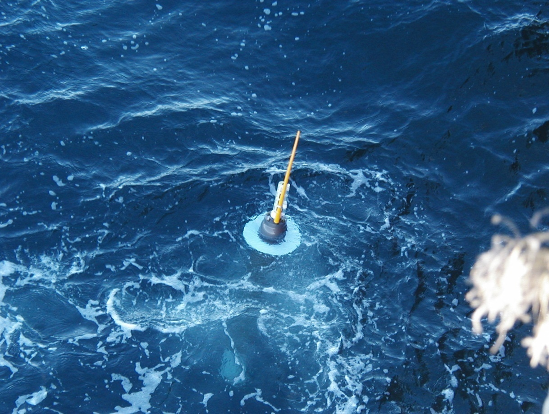
Tools of the Trade

Slide 2
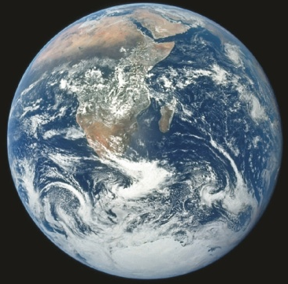
What is the best way to observe the ocean?
What are the independent variables of the ocean state?
How was the ocean observed so far…
What processes to observe
Who is driving who?
What technologies are available
How does our understanding of the ocean change our future observation strategies?

Slide 3
Oceanography is an observationally driven field!
What are the independent variables for the ocean?
What do they measure and what is their use?
Geological: coastlines, bathymetry, sediment thickness
Physics: Temperature, horizontal velocity, vertical velocity, Sea-surface height
Biology: Chl-a, Productivity, Zooplankton, Phytoplankton, Fish and Egg counts, etc
Chemistry: Salinity, Carbon, Nitrogen, Iron, Oxygen…

Slide 4
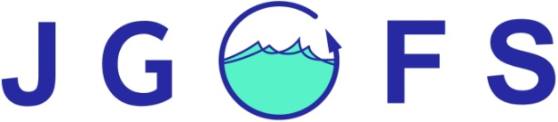
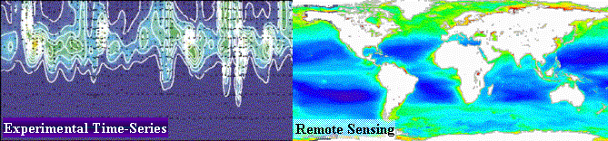
International Observational Programs
The Joint Global Ocean Flux Study (JGOFS)
was launched in 1987 at a planning meeting in Paris
The Operational Goal of JGOFS :
Spatial Scale: regional to global
Temporal Scale: seasonal to interannual
1) Fluxes of carbon between the atmosphere-surface ocean-ocean interior.
2) Sensitivity to climate changes

Slide 5


International Observational Programs
The World Ocean Circulation Experiment
1990-1998
http://woce.nodc.noaa.gov/wdiu/
International Programme on Climate Variability and Predictability, 1995-present
http://www.clivar.org
World Climate Research Programme
http://wcrp.wmo.int

Slide 6
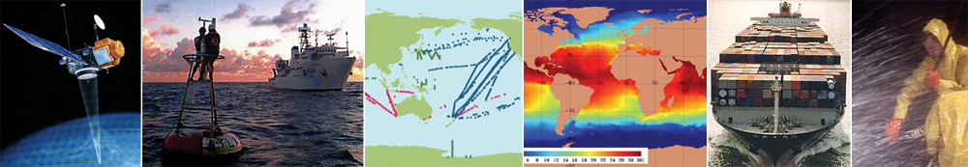
How do we keep it all together? What role does it play? Where are we? Where are we going?
NASA, NOAA, JCOMMOPS, FNMOC, CRT, URK

Slide 7
Global Ocean Observing System
GOOS is designed to embrace the oceans as a single entity, to provide a global view of the ocean system.
GOOS is a system of programmes,
GOOS is designed to:
Monitor, understand and predict weather and climate
Describe and forecast the state of the ocean, including living resources
Improve management of marine and coastal ecosystems and resources
Mitigate damage from natural hazards and pollution
Protect life and property on coasts and at sea
Enable scientific research

Slide 8
Global Ocean Observing System
GOOS is designed to embrace the oceans as a single entity, to provide a global view of the ocean system.
GOOS is a system of programmes,
GOOS is designed to:
Monitor, understand and predict weather and climate
Describe and forecast the state of the ocean, including living resources
Improve management of marine and coastal ecosystems and resources
Mitigate damage from natural hazards and pollution
Protect life and property on coasts and at sea
Enable scientific research

Slide 9
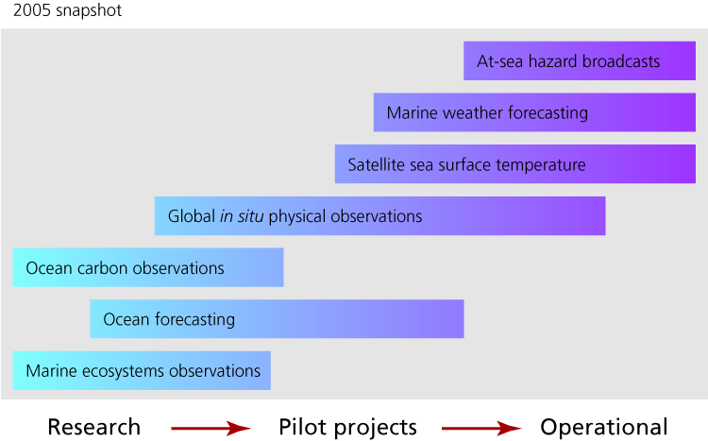
GOOS is evolving
Notes:
The goal of GOOS is to foster the movement of elements from research,
through pilot projects proving worth and connecting with users,
to operational implementation.

Slide 10
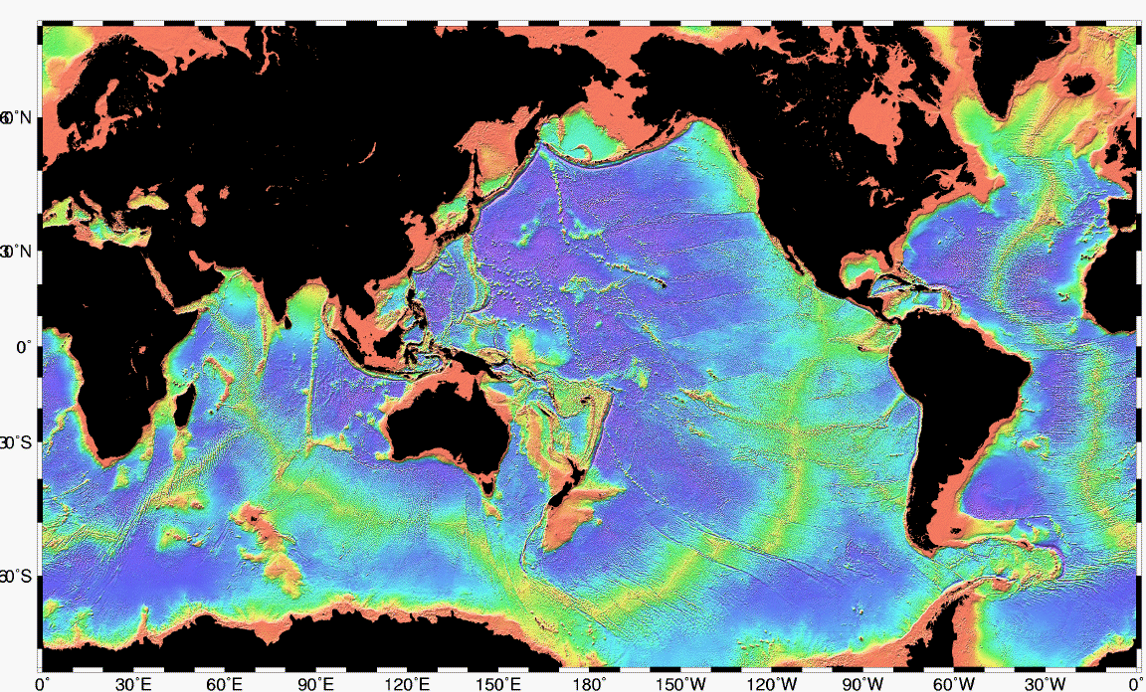
GOOS Regions
Eu
EuroGOOS
BS-GOOS
NEAR-GOOS
IOCARIBE-GOOS
MedGOOS
GOOS-AFRICA
SEA-GOOS
AF
PI-GOOS
IO-GOOS
GRASP
SOOS

Slide 11
Provision of observing platform – equipment requirements
research vessels
moorings
satellites
submersibles
towed vehicles
floats and drifters including gliders – Marcel will give a lecture on Gliders later

Slide 12
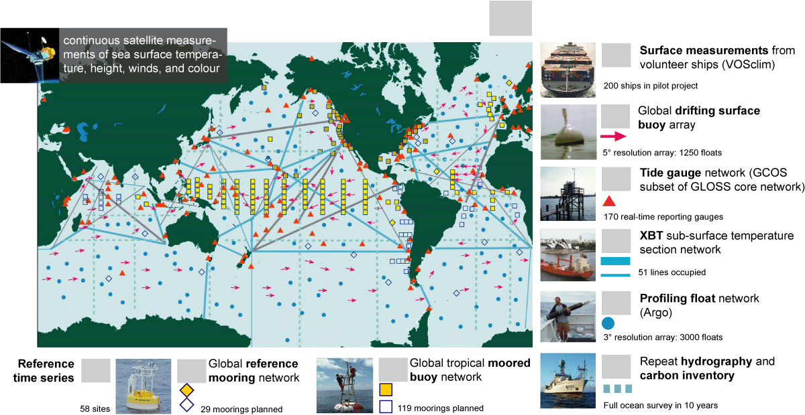
continuous satellite measurements
Total in situ networks
93%
July 2012
90%
100%
60%
98%
100%
21%
48%
72%
55%

Slide 13
Marine Instrumentation are required for:
Marine Geology
Marine Biology
Physical Oceanography
Chemical and Biogeochemical Oceanography
Remote Sensing
Bio-optics

Slide 14
http://www.whoi.edu/ships_technology/

Slide 15
Some definitions
Lagrangian - measurements following the flow. Examples: drifters, floats
Eulerian – measurements at a fixed location. Examples: single profiles, moored instruments, satellites, spatial averages of Lagrangian measurements
Time series - measurements over time, usually at regular intervals, long enough for spectral analysis of frequency content
Synoptic – “snapshot”

Slide 16
Options for ocean observations
1. Remote sensing (satellite)
2. In-situ
(in the water)
3. ship-based
4. autonomous
Drifting (Lagrangian)
Fixed (Eulerian)
steered
Notes:
Lecture follows this as an outline

Slide 17
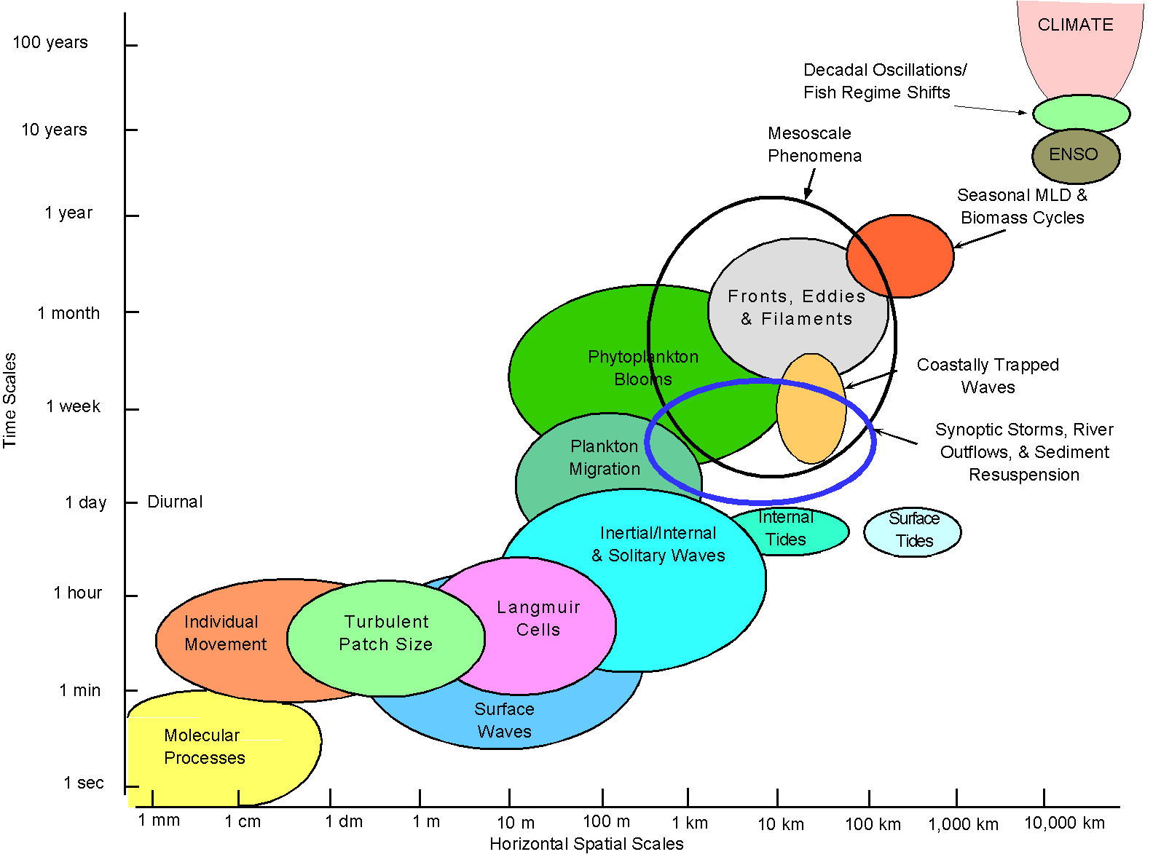
Ocean scales

Slide 18
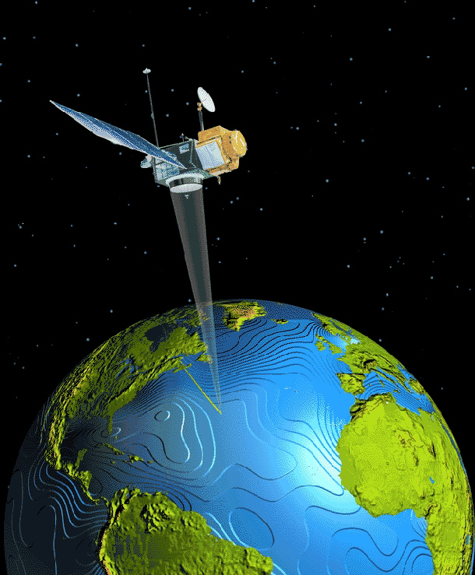
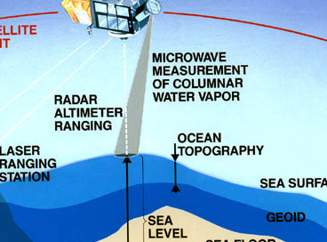
Remote sensing (satellites) Sea surface height: Altimetry
Rationale:
cm-accuracy sea-surface height
geostrophic surface flow relative to geoid
heat storage from large-scale steric effect
variability from 20-10000km, 20days-10years
Challenges and limitations:
geoid insufficient at <3000km
aliasing of tides at 62, 173,... days
aliasing of high-frequ. wind-forced variability
extrapolation to ocean interior
no coverage in polar (and ice-covered) regions
land motion of tide gauges for SL rise

Slide 19
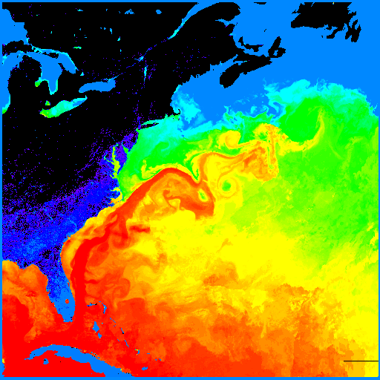
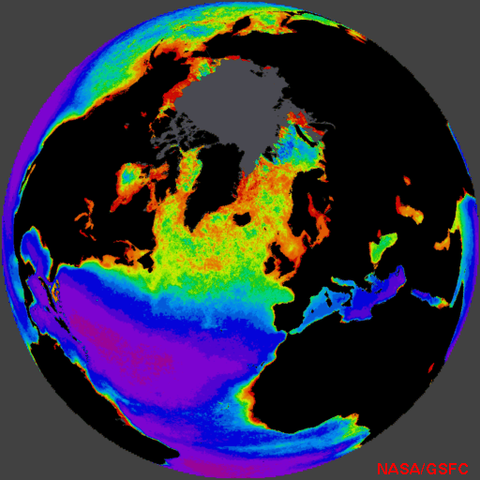
Remote sensing SST Ocean Color
Sea surface temperature from infrared and now also microwave imaging.
Senses only “skin temperature“
Color gives surface chlorophyll and other parameters. Calibrations are still uncertain and cannot see subsurface content
Gulfstream temperature spring plankton bloom
and other quantities (wind, ice, waves, mass, salinity,….)

Slide 20
Examples of Satellite Data Websites:
Overview over some satellite-derived products: http://podaac.jpl.nasa.gov/
Altimetry:
http://www.aviso.oceanobs.com/
http://las.aviso.oceanobs.com/las/servlets/dataset/
ftp://ftp.cls.fr/pub/oceano/AVISO/SSH/duacs/
Ocean color and SST (MODIS, SeaWIFS, ...) http://oceancolor.gsfc.nasa.gov/
Ocean surface currents
(using wind, altimetry:) http://www.oscar.noaa.gov/
(from sequential satellite imagery:) http://ccar.colorado.edu/research/cali/
GRACE gravimetry
http://op.gfz-potsdam.de/grace/
http://podaac.jpl.nasa.gov/DATA_CATALOG/graceinfo.html

Slide 21
2. In situ sampling: sensors carried on many different platforms
Temperature: thermistors
Salinity: conductivity sensors
Pressure: quartz transducers
(CTD: instrument carrying T, S, P plus ancillary sensors)
(XBT: expendable temperature probe)
Depth: altimeters (sound or EM wave reflection)
Velocity:
current meters (mechanical with compass)
acoustic doppler current meters
floats and drifters (moving with the water)
Other sensors:
Oxygen, chlorophyll fluorometer, optical properties and radiation sensors

Slide 22
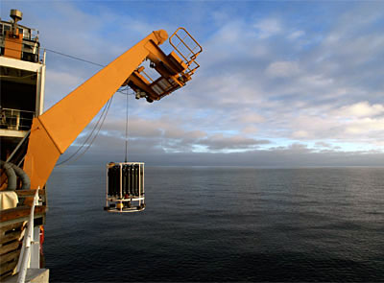
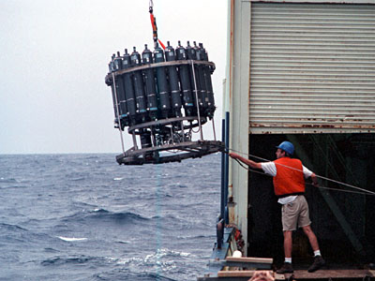
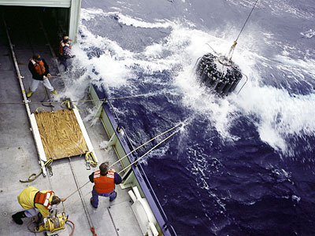
CTDs
Niskin bottles
ADCP
XBT system
Remote sensors
Drifters
Moorings

Slide 23
CTDs
Niskin bottles
ADCP
XBT system
Remote sensors
Drifters
Moorings
What is it and why do we use it?
A CTD stands for Conductivity, Temperature, and Depth.
Primary tool for determining essential physical properties of sea water.
Provides a precise and comprehensive charting of the distribution and variation of water temperature, salinity, and density. How does it work?
Made up of a set of small probes attached to a large metal rosette.
Rosette is lowered on a cable down to the seafloor and real time data available.
Water bottles can be closed selectively as the instrument ascends.
A standard CTD cast, depending on water depth, requires 2-5 hours.
Water sampling is often done at specific depths so scientists can learn the physical properties of the water column are at that particular place and time.

Slide 24
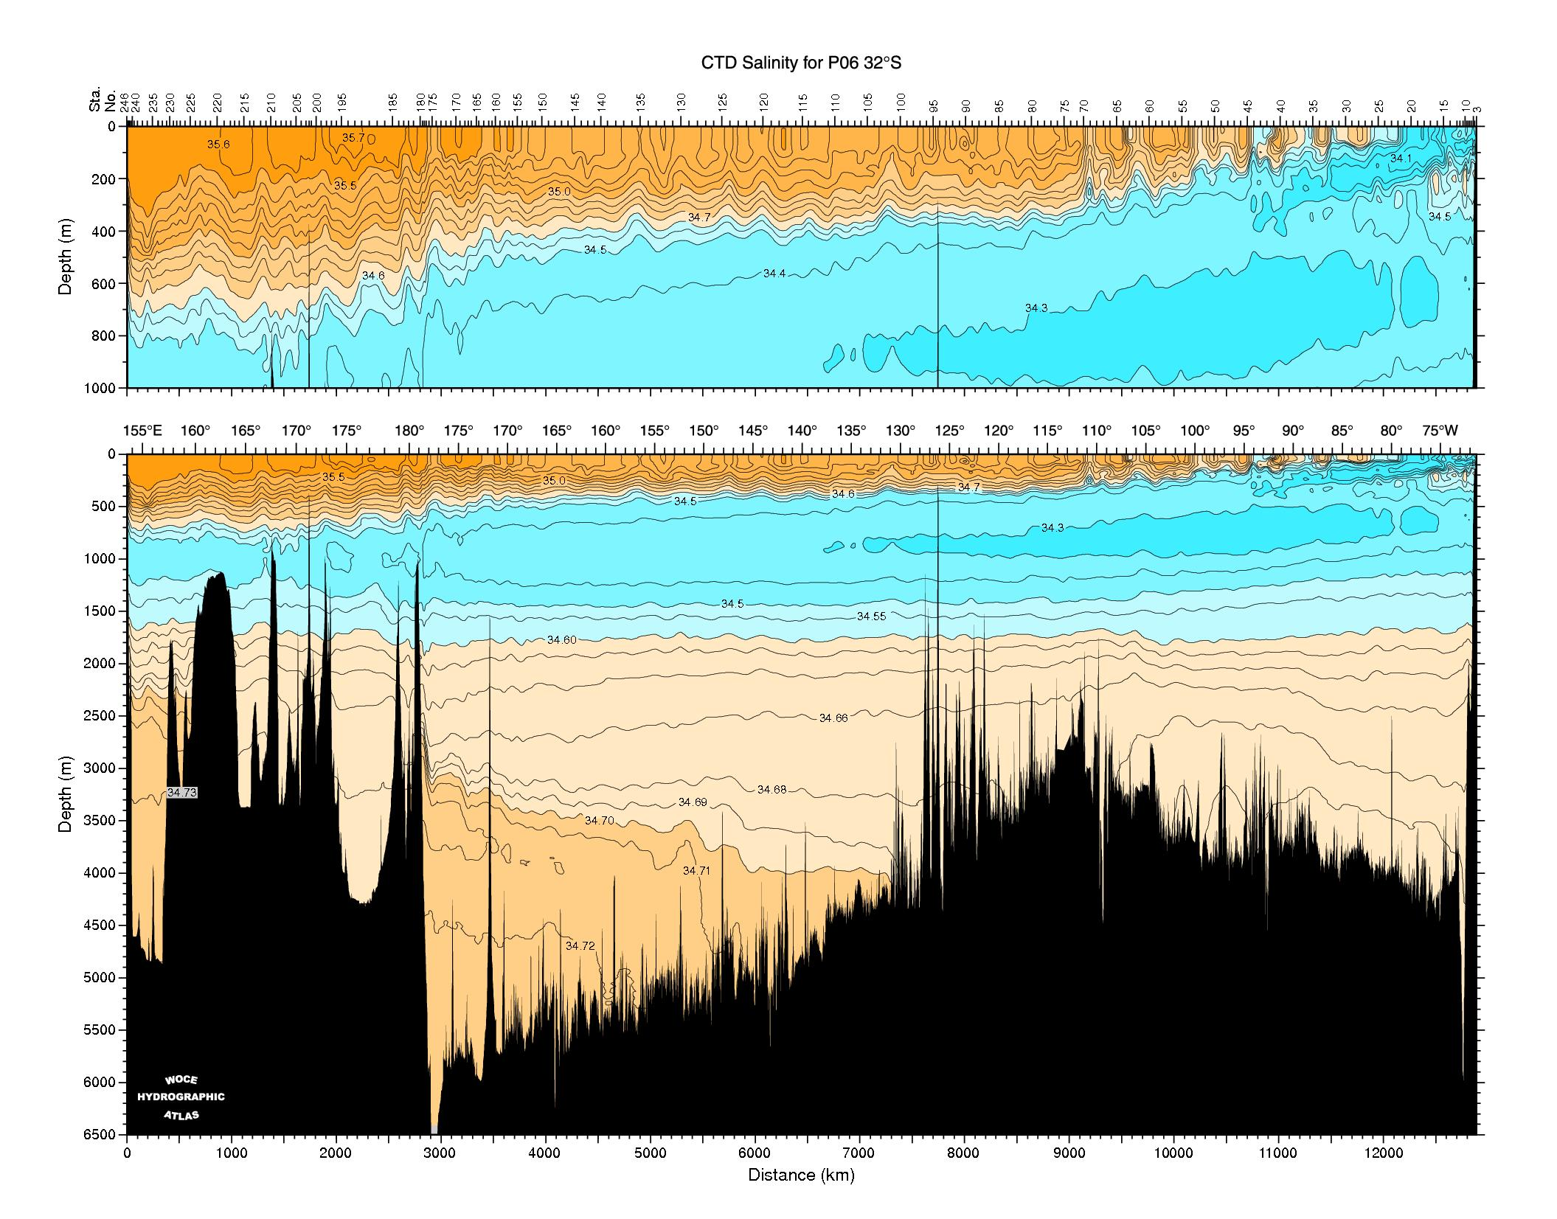
Typical CTD data sections

Slide 25
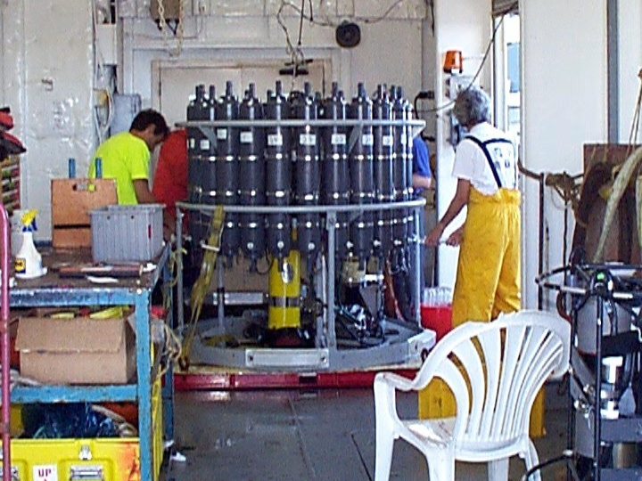
Drawing samples from the rosette

Slide 26
CTDs
Niskin bottles
ADCP
XBT system
Remote sensors
Drifters
Moorings
What platforms are needed?
There can be a host of other accessories and instruments attached to the CTD package.
These include Niskin bottles that collect water samples at different depths for measuring chemical properties,
Acoustic Doppler Current Profilers (ADCP) that measure the horizontal velocity, and oxygen sensors that measure the dissolved oxygen content of the water. Advantages - Very accurate - Collects water samples for analysis
- Can be used at depths up to several thousand meters Disadvantages: - More complex to operate and expensive
- Limited to single station
- Takes time to operate and collect samples

Slide 27
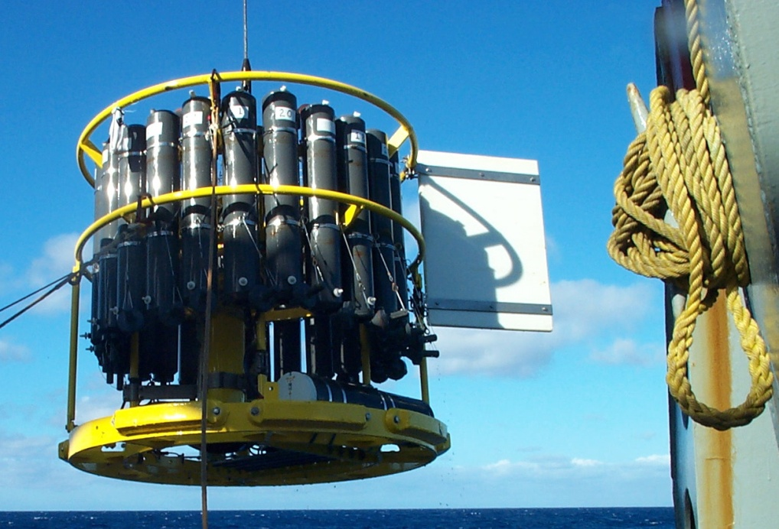
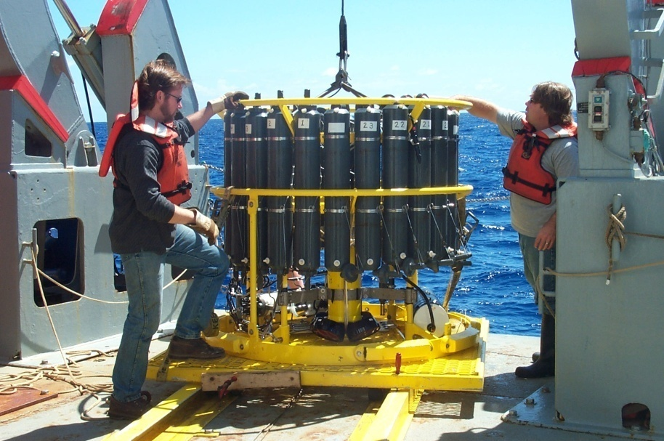
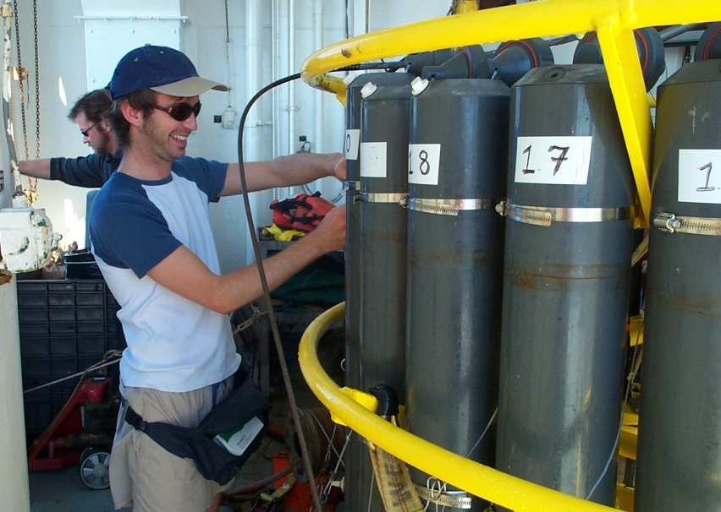
Water samples are
Collected for the analysis of:
Oxygen
Salinity
Nutrients
CO2
CFC
Plankton etc..
YOU NEED NISKIN BOTTLES FOR THIS!

Slide 28
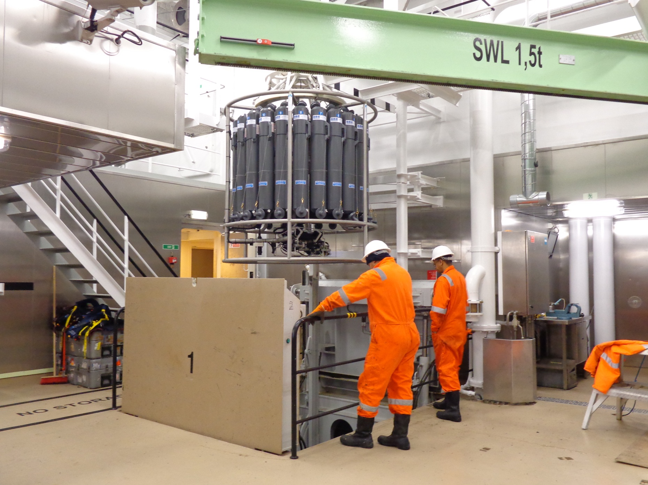

Slide 29
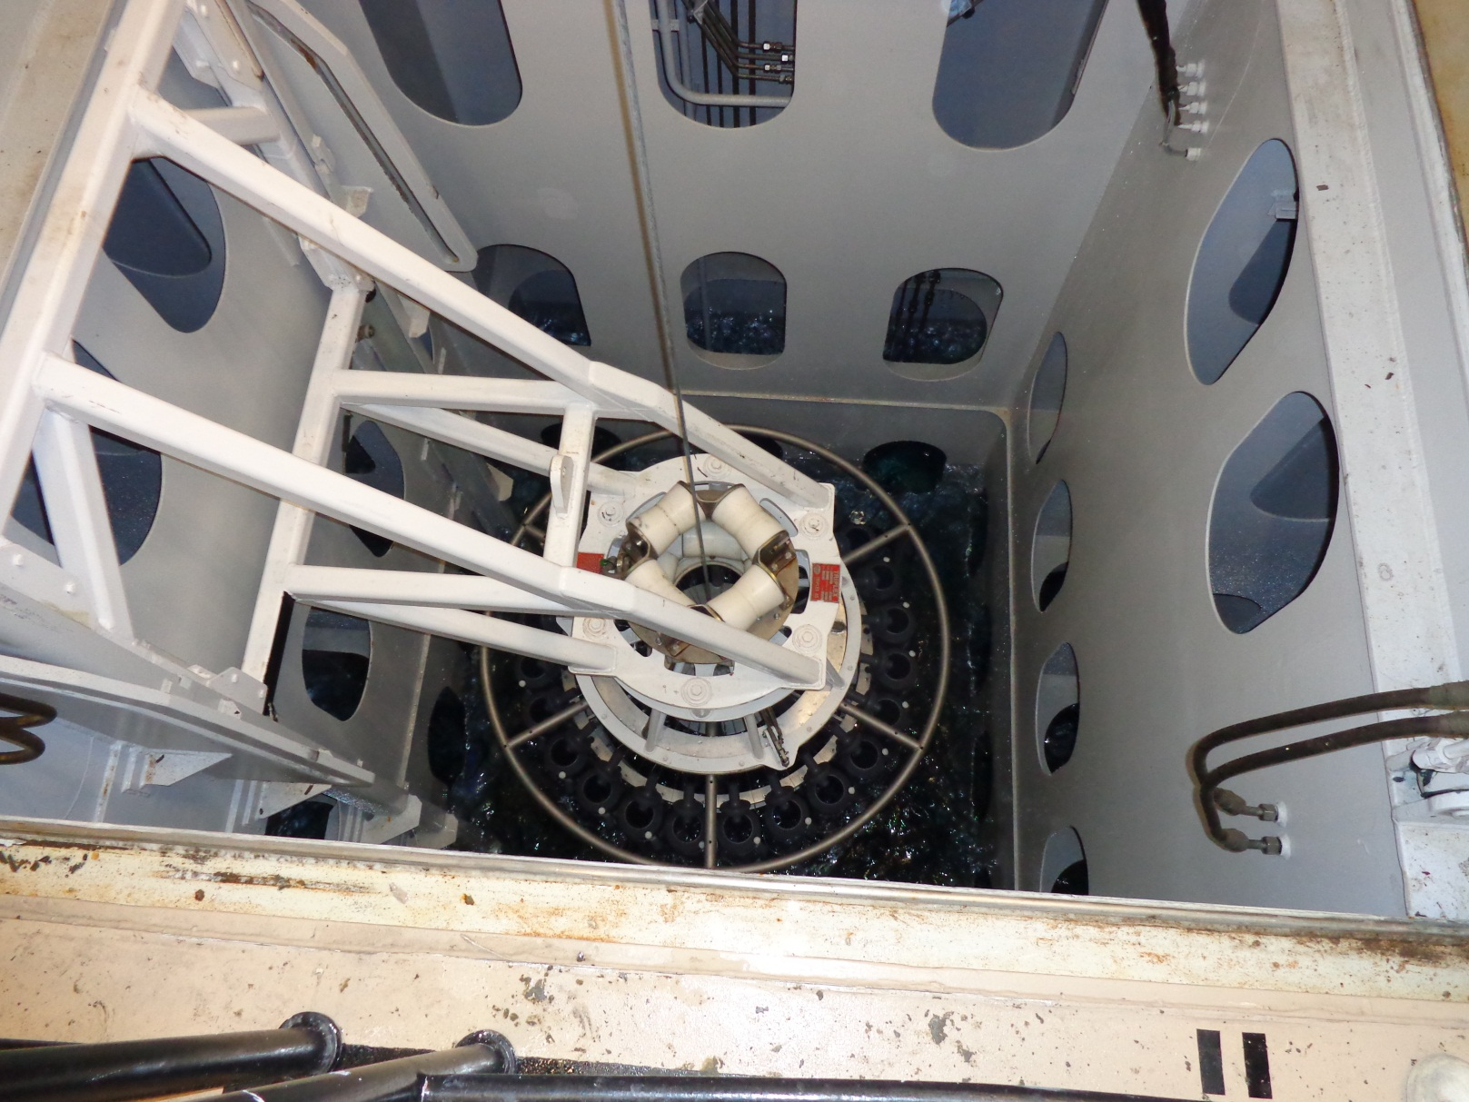

Slide 30
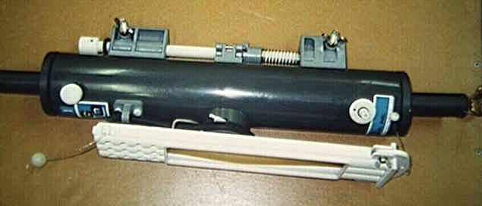
CTDs
Niskin bottles
ADCP
XBT system
Remote sensors
Drifters
Moorings
Plastic, (eliminates chemical reaction between the bottle and the sample)
Top and bottom valves are held open and closed at precise depths on the upcast.
Niskin bottles of different sizes are used for sample collection for various tracers.

Slide 31
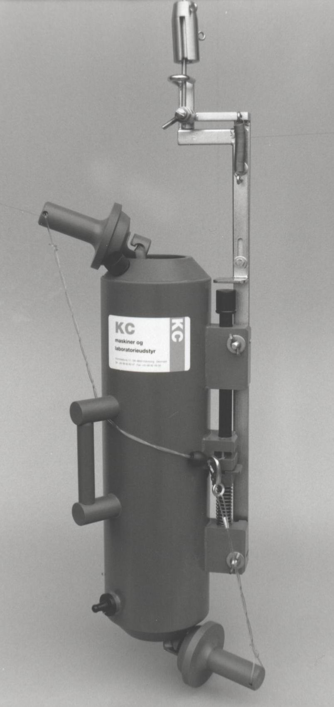
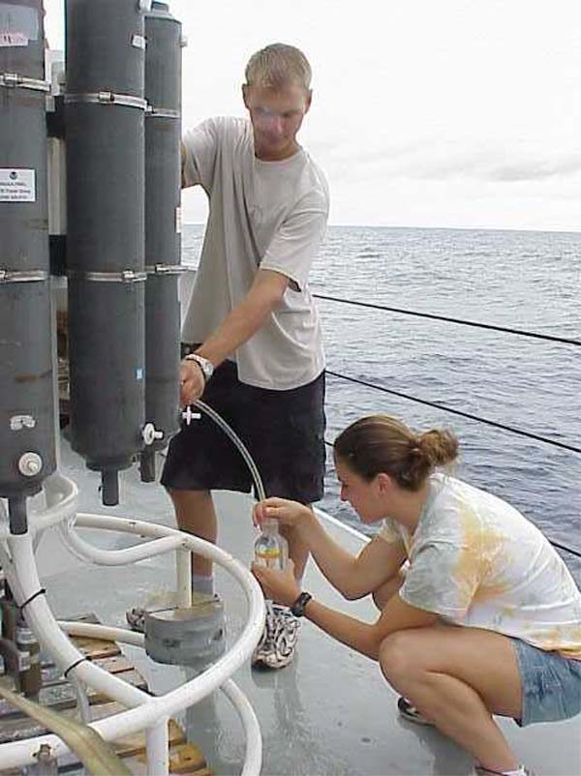

Slide 32
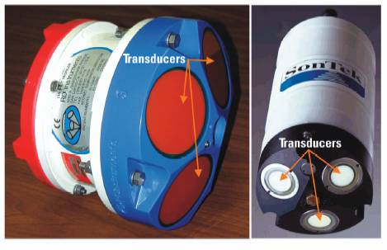
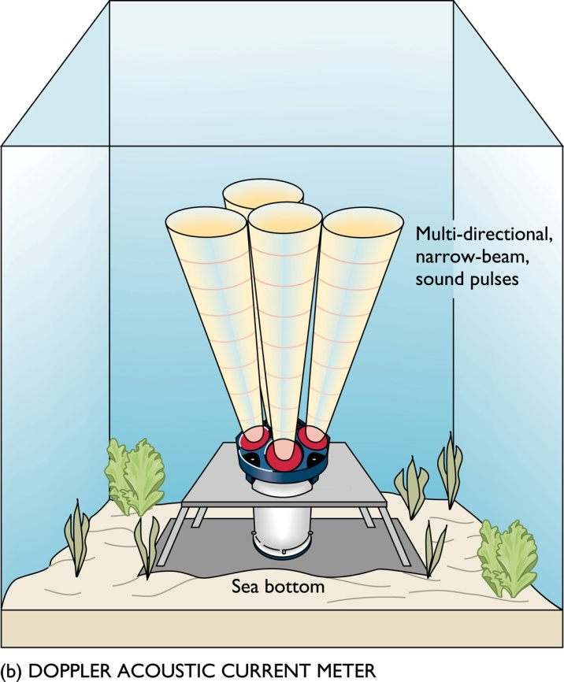
CTDs
Niskin bottles
ADCP
XBT system
Remote sensors
Drifters
Moorings
What is it and why do we use it?
An Acoustic Doppler Current Profiler (ADCP).
Measures velocity and direction of water.
Shipboard or anchored

Slide 33
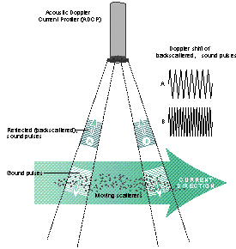
How does it work?
The ADCP measures water currents with sound, using a principle of sound waves called the Doppler effect.
The ADCP works by transmitting "pings" of sound at a constant frequency into the water.
As the sound waves travel, they ricochet off particles suspended in the moving water, and reflect back to the instrument.
Due to the Doppler effect, sound waves bounced back from a particle moving away from the profiler have a slightly lowered frequency when they return.
The difference in frequency between the waves the profiler sends out and the waves it receives is called the Doppler shift.
The instrument uses this shift to calculate how fast the particle and the water around it are moving.

Slide 34
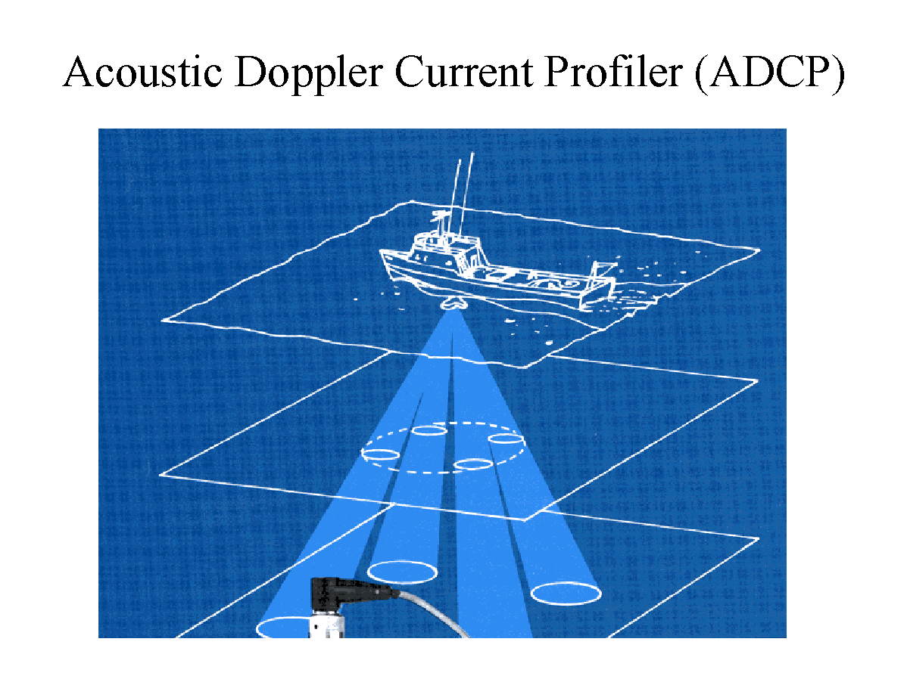
http://nome.colorado.edu/HARC/adcp/adcp_data.html

Slide 35
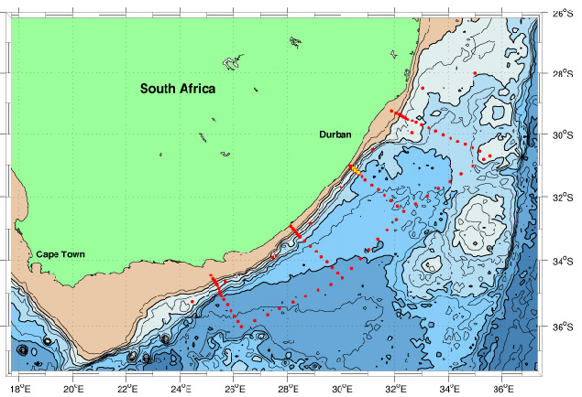
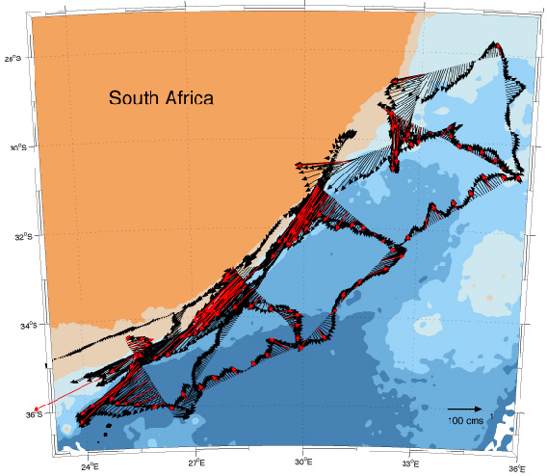

Slide 36
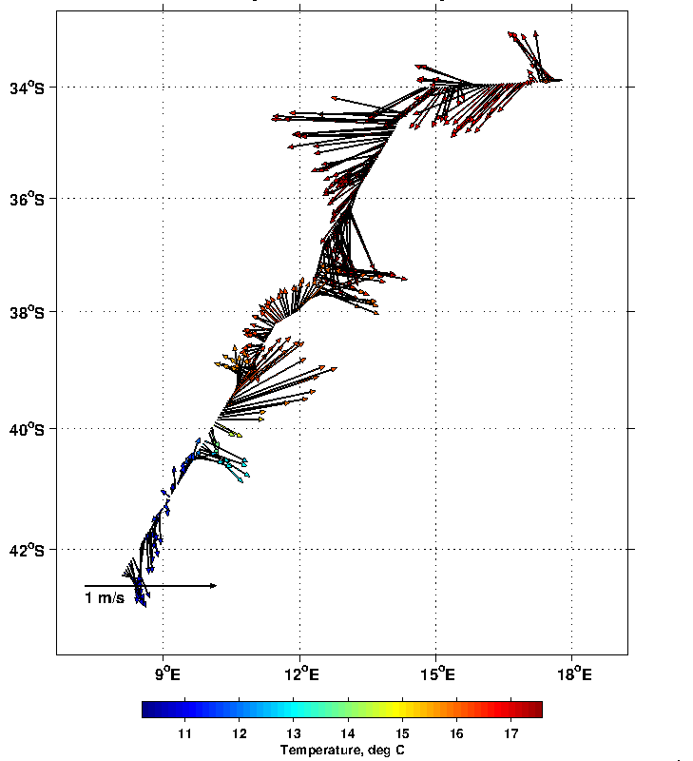

Slide 37
CTDs
Niskin bottles
ADCP
XBT system
Remote sensors
Drifters
Moorings
Advantages:
Measures small scale currents
ADCPs measure the absolute speed of the water
Measures a water column up to 1000m deep
Disadvantages:
High frequency pings yield more precise data, but low frequency pings travel farther in the water.
ADCPs set to "ping" rapidly also run out of batteries rapidly
If the water is very clear, as in the tropics, the pings may not hit enough particles to produce reliable data
Bubbles in turbulent water or schools of swimming marine life can cause the instrument to miscalculate the current
Users must take precautions to keep barnacles and algae from growing on the transducers.

Slide 38
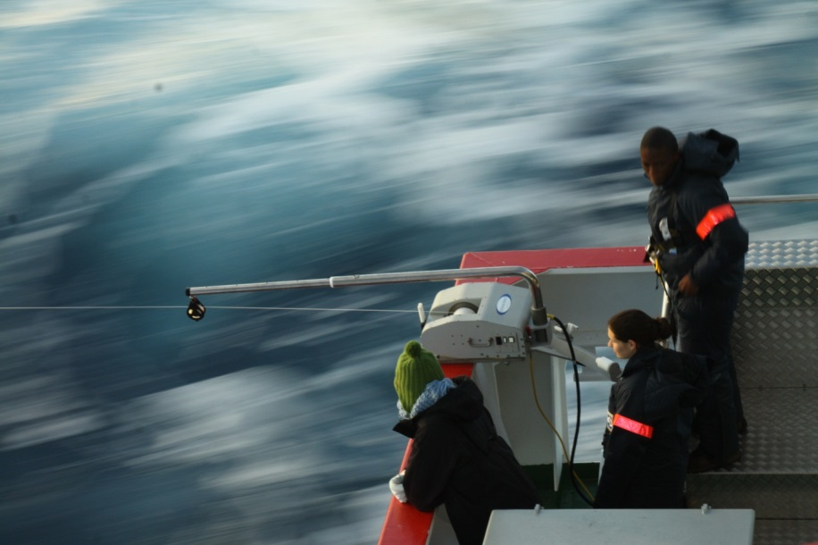
Using an underway CTD (UCTD)
It’s a combination of CTD plus the ability to be towed so the ship does not need to stop..
Depths of UCTD fall dependant on ships speed..

Slide 39
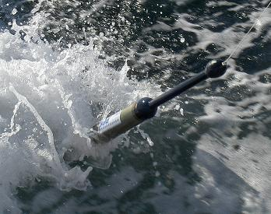
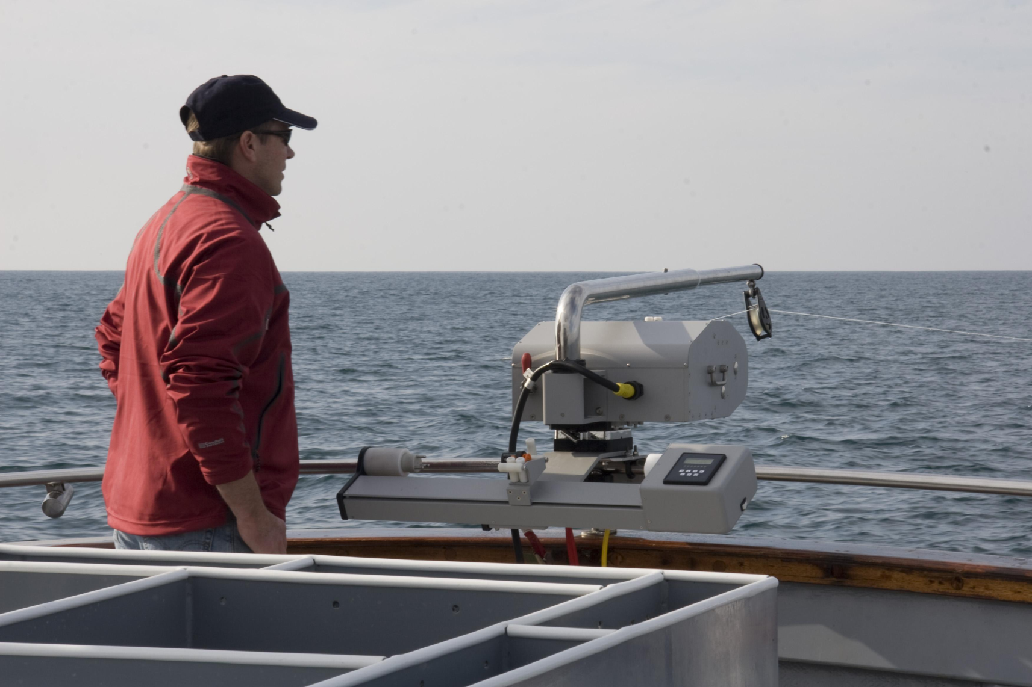
http://www.oceanscience.com/Products/Underway-Systems/Underway-CTD.aspx

Slide 40
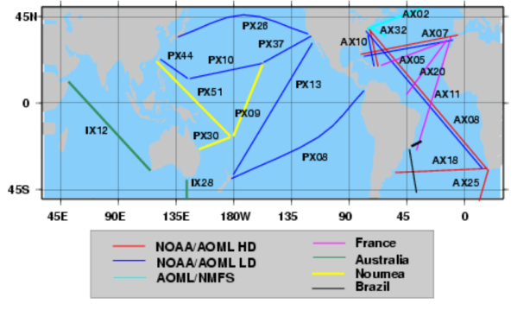
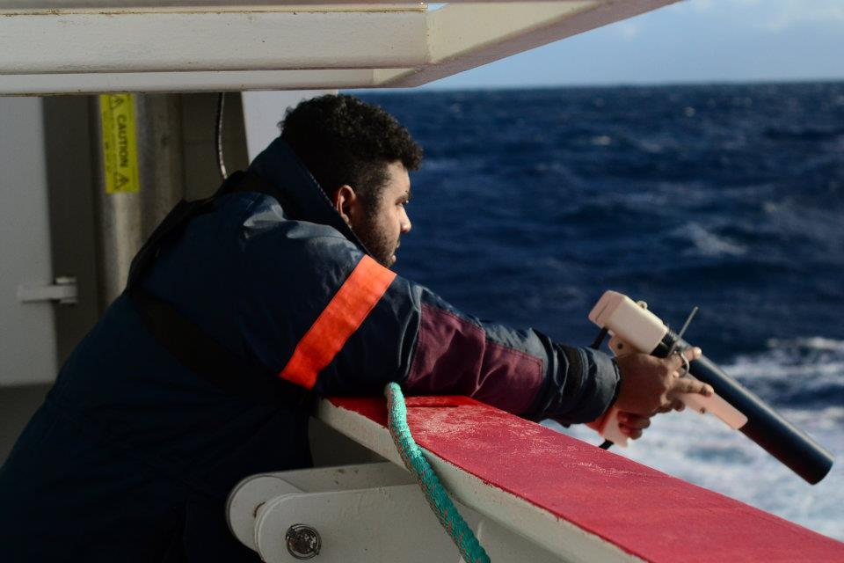
CTDs
Niskin bottles
ADCP
XBT system
Remote sensors
Drifters
Moorings

Slide 41
Ship-based: Volunteer Observing Ships (VOS) or Ships Of Opportunity (SOO)
Commercial ships (ferries, container vessels, etc) which carry out various observations on the way, or deploy probes/instruments
Main requirement:
must be able to do this at full speed
should take minimum effort/attendance by crew
modifications to ship should be small
Advantages:
Cheap
frequent trans-basin coverages
Disadvantages:
startup effort is large
limited sensors
speed
ships may be moved

Slide 42
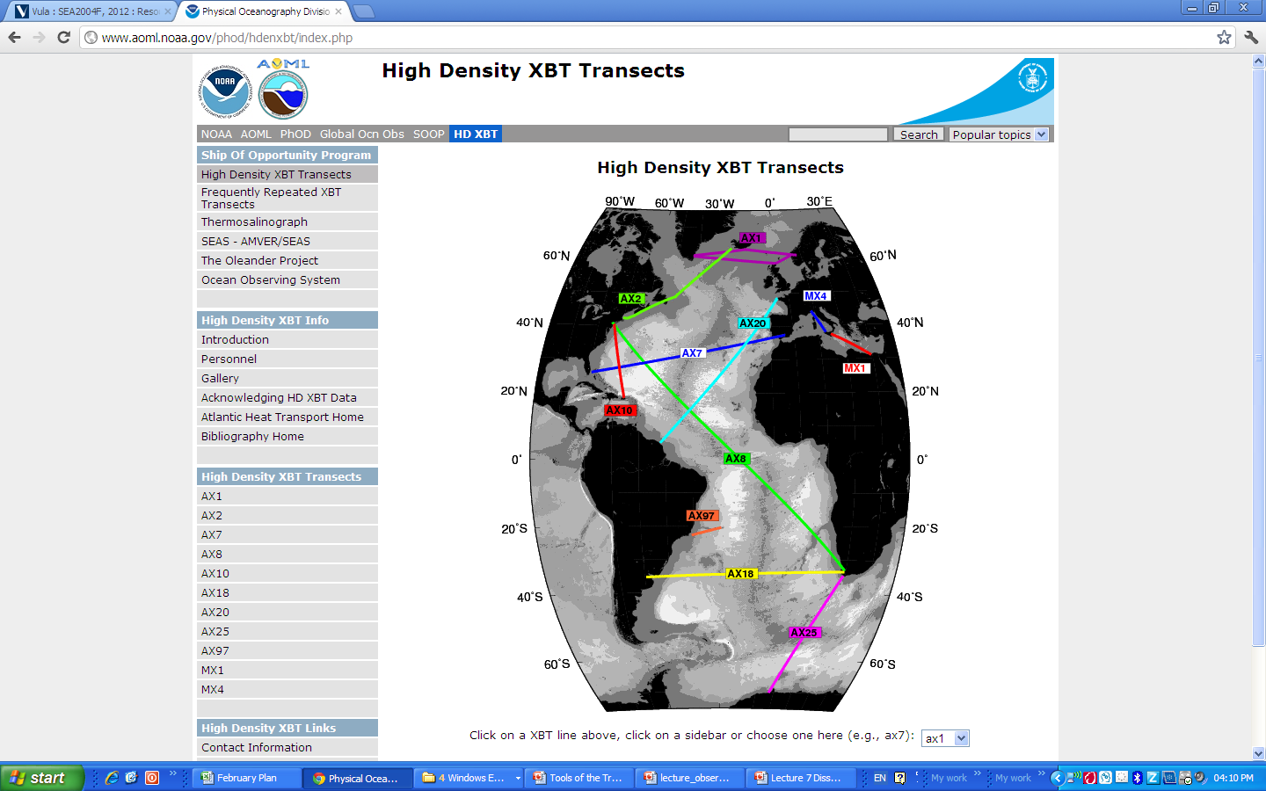

Slide 43
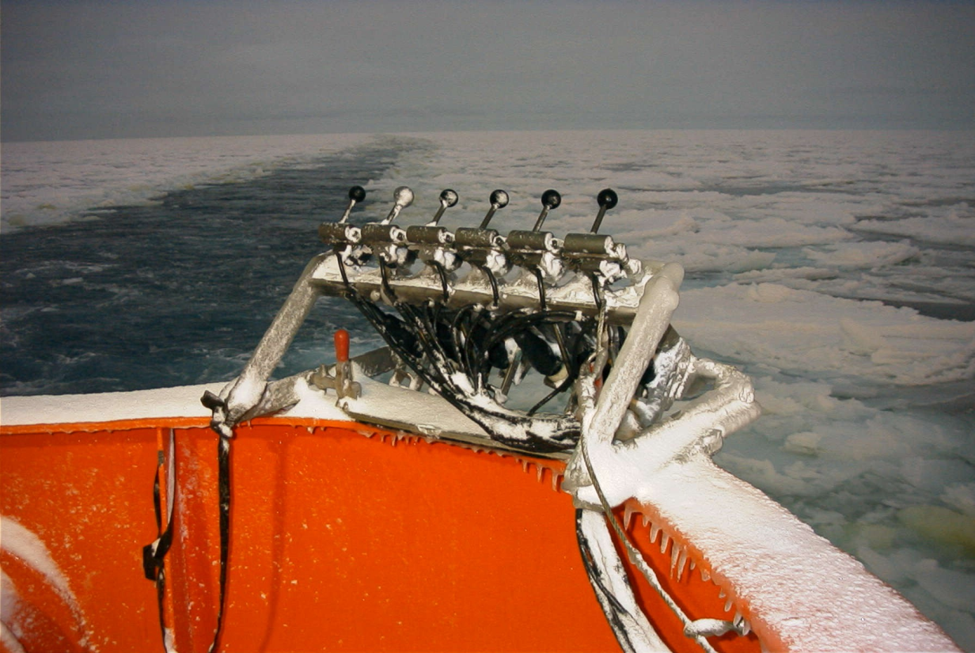
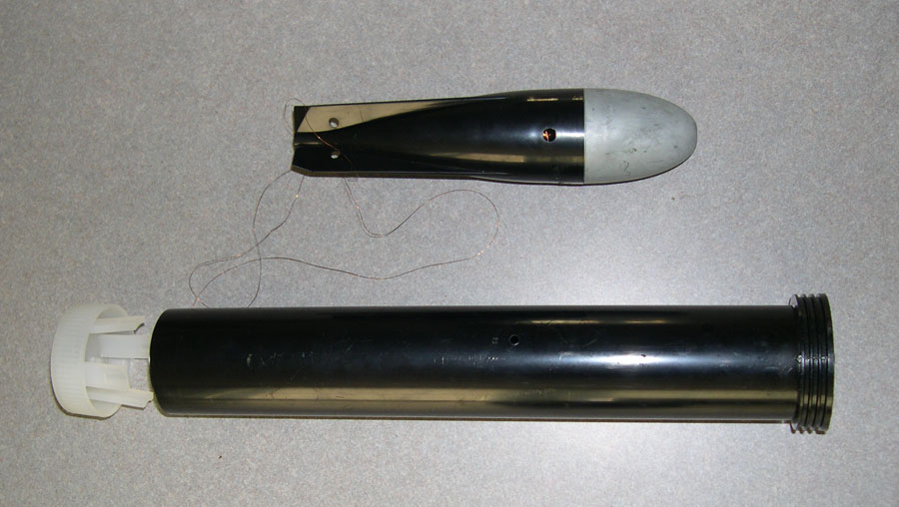
Biases due to manufacturing changes and fall-rate issues are still an active and hot discussion/research topic…
Sensor good to 0.05C but fallrate random error can give 0.1-0.2C, and fall-rate biases can be the same (that needs to be resolved)
SPEAK TO KATHERINE HUTCHINSON ABOUT HER 2011 HONOURS PROJECT!!

Slide 44
CTDs
Niskin bottles
ADCP
XBT system
Remote sensors
Drifters
Moorings
How do they work
An XBT is a probe that is dropped from
a ship and measures the temperature as it
falls through the water.
Two very small wires transmit the temperature
data to the ship where it is recorded for later
analysis.
The probe is designed to fall at a
known rate, so that the depth of the probe can
be inferred from the time since it was launched.

Slide 45
CTDs
Niskin bottles
ADCP
XBT system
Remote sensors
Drifters
Moorings
Advantages
Can be deployed underway
Rapid transfer of temperature
Data can be obtained over 1000 m
Disadvantages
Only Temperature is recorded
Accuracy not as good as a CTD
Underway observations
XBT observations are used to investigate the large-scale, low-frequency modes of climate variability.
These lines are ideally covered 12 times per year with an XBT drop every 150 to 200 km.

Slide 46
Other VOS systems:
Thermosalinograph, CO2, other chemicals (from pumped engine cooling water intake), ADCP current profiles, towed plankton recorder,….
Underway data project offices / data centers:
www.jcommops.org/soopip/
www.coriolis.eu.org//cdc/default.htm

Slide 47
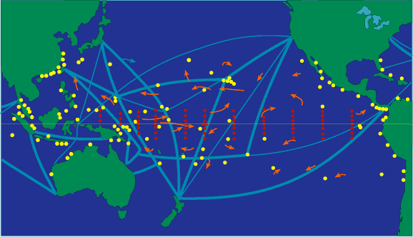
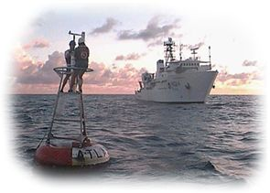
CTDs
Niskin bottles
ADCP
XBT system
Remote sensors
Drifters
Moorings

Slide 48
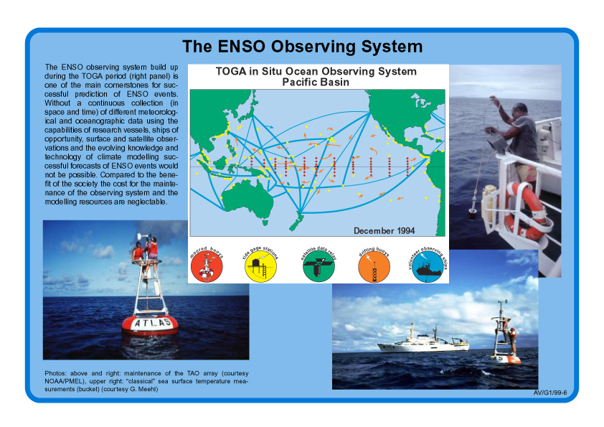
Tropical Atm-Ocn

Slide 49
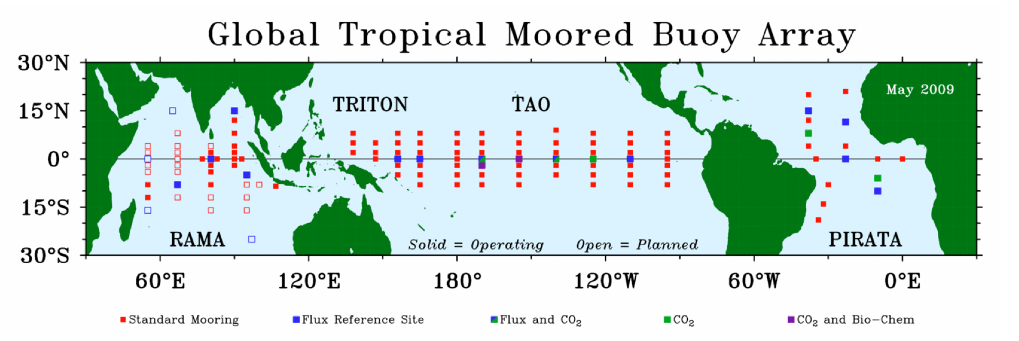

Observing system: TAO/Pirata array: tropical ocean - atmosphere

Slide 50





Slide 51


Slide 52

OceanSITES program – network of moored ocean observatories (bottom and surface moorings)
http://www.whoi.edu/virtual/oceansites/index.html

Slide 53


Slide 54

DEEP SEA MOORING
A typical deep-sea mooring design sketch for a mooring deployment in 4000 m water depth. Instrument design depths are shown in dark red.
The acoustic doppler current profiler (ADCP) is mounted in the main buoyancy body at 300 m. It looks upward and covers the upper 250 - 300 m of the water column with a resolution of one reading every 8 m.
The first recording current meter (RCM) is placed at 320 m, followed by more recording current meters at regular intervals. Additional buoyancy, shown as yellow clusters of small buoys, is placed above each RCM to compensate its weight in water.
Above the anchor weight is an acoustic release (ACR) which, when triggered, severs the connection to the anchor weight so that the mooring floats to the surface.

Slide 55
CTDs
Niskin bottles
ADCP
XBT system
Remote sensors
Drifters
Moorings
Moorings are appropriate platforms wherever measurements are required at one location over an extended time period.
Their design depends on the water depth and on the type of instrumentation for which the mooring is deployed, but the basic elements of an oceanographic mooring are an anchor, a mooring line (wire or rope) and one or more buoyancy elements which hold the mooring upright and preferably as close to vertical as possible.
To keep the mooring close to the vertical it should have minimum drag, which can only be achieved by keeping the wire diameter small. This requires a small wire load from the instruments.
Additional buoyancy is therefore distributed along the wire to compensate for the weight of the instrumentation. The buoyancy is arranged so that all sections of thew mooring are buoyant, enabling recovery of a damaged mooring which lost its upper part.

Slide 56


Inverted echosounder & bottom pressure sensor (PIES)
Bottom Pressures from 3 sensors 2000-2001:
agreement to a few mm over 5000m = 5x10⁻⁷

Slide 57



SAMBA – South Atlantic Mooring Basin Array under SAMOC July 2013 Moorings across the South Atlantic – north/southward pathways between the Southern Ocean and South Atlantic

Slide 58
Comparisons of the different observing systems
Platform strengths weaknesses
Research vessels - can take samples - very sparse sampling
($25000/day) - handle/deploy heavy equipment - expensive (too much for operational
- reach remote areas (use like VOS) obs, but needed for servicing)
VOS - high resolution along repeat tracks - tracks not always where wanted
(free) - for surface reading many variables - tracks may change, they don‘t stop
- no subsurface except T (800m)
Surface drifters - global coverage - sparse spatial sampling
($2000) - rapid sampling in time - only surface obs
- low-cost, robust technology - limited variables (T, air p, S)
Floats - global coverage - coarse x,y,t resolution
($15000+5000) - vertical profiling to mid-depth - limited weight/power for sensors
- “cheap“ so large numbers feasible - avoid or quickly leave certain regions
Moorings - high time resolution, surface to bottom - no x,y resolution
($250000) - many variables possible - expensive, incl. ships needed
- can monitor adverse/difficult locations - large technical effort/few groups
- re-calibrations, so can be reference
Gliders - good sampling along tracks - very slow (20-25cm/s)
($70000) - free choice of track, can be steered - limited depth range and variables
- small sensor suite feasible
Integrals - integrate over long distances - expensive
- good time resolution - limited variables and places possible
Coastal radars - good x,y,t resolution - limited coverage
- land based - only surface, only currents and waves

Slide 59

Where are the Gaps in GOOS?

Slide 60
~50% of the planned in-situ GOOS climate network ($)
Polar regions and deep ocean (technology)
Developing countries (Capacity building)
Non-physical variables ..BUT IMPROVING(Biology, Chemistry, …)
Quality assurance

Slide 61
Date Type | Where
ARGO | http://www.usgodae.org/argo/argo.html
SVP DRIFTER | http://www.aoml.noaa.gov/phod/dac/gdp_drifter.php
ALTIMETRY | http://www.aoml.noaa.gov/phod/dataphod/work/trinanes/INTERFACE/ http://eddy.colorado.edu/ccar/data_viewer/index http://www.aviso.oceanobs.com/en/
CHL-A | http://eddy.colorado.edu/ccar/data_viewer/index http://disc.sci.gsfc.nasa.gov/gesNews/unesco_ioc_bulletin http://oceancolor.gsfc.nasa.gov/
BATHMETRY | http://www.gebco.net/
TEMPERATURE | https://www.ghrsst.org/ http://sst.jpl.nasa.gov/SST/
OCEAN MODEL- SODA | http://ferret.pmel.noaa.gov/NVODS/getUI.do
WORLD OCEAN DATA | http://www.nodc.noaa.gov/OC5/SELECT/dbsearch/dbsearch.html
GENERAL | http://ferret.pmel.noaa.gov/NVODS/getUI.do

